Slide 1

Trains Final Project
By: Chevroen, Shavon, & Naveena

Slide 2
Background
Why trains?
We chose trains because it has become a lost method of transportation in the Midwest
Trains are a great way to see the country from a different perspective from driving or flying
Traveling by train has a benefits for the entire family
Traveling by train can be very relaxing
Can be cheaper than other methods of travel

Slide 3
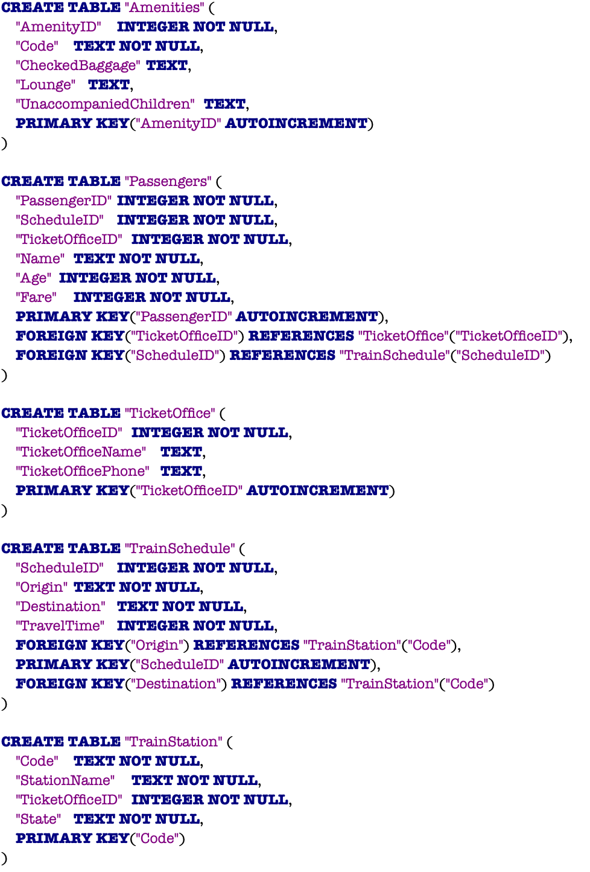

SQLite3

Slide 4
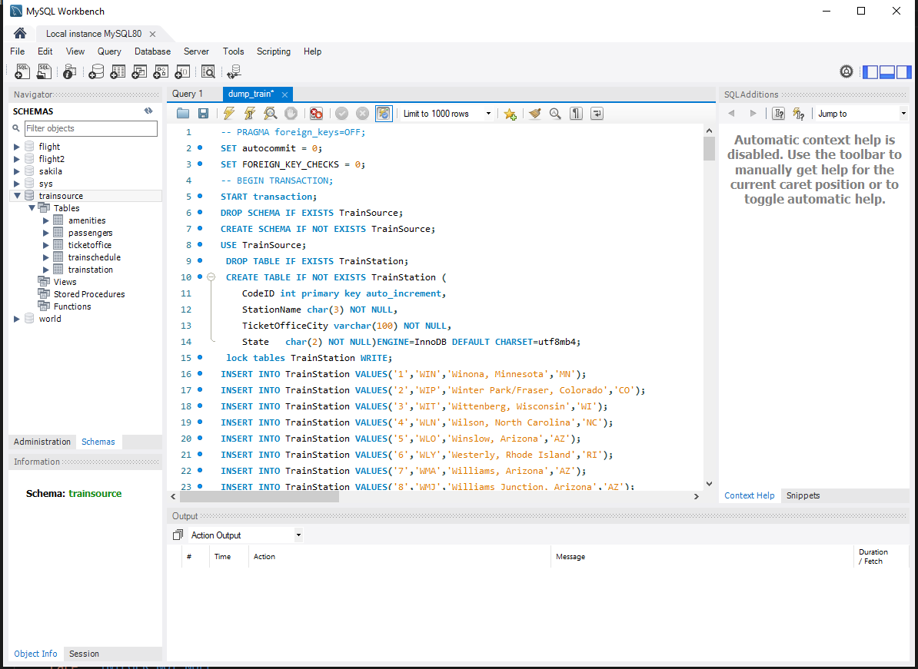
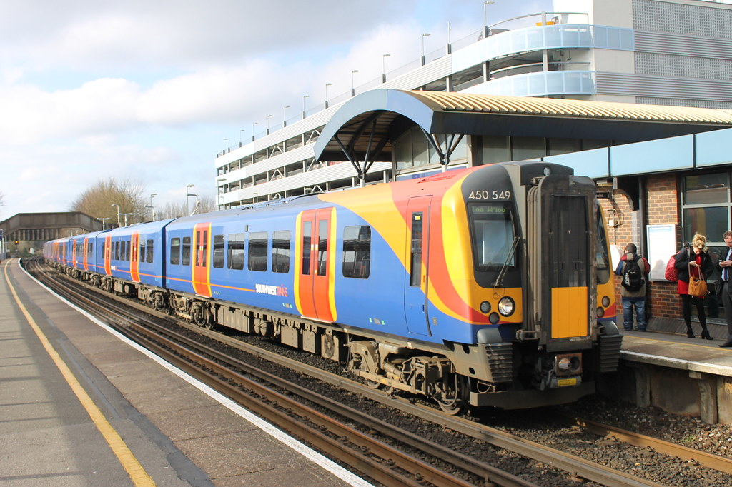
Mysql
This Photo by Unknown author is licensed under CC BY-ND.

Slide 5
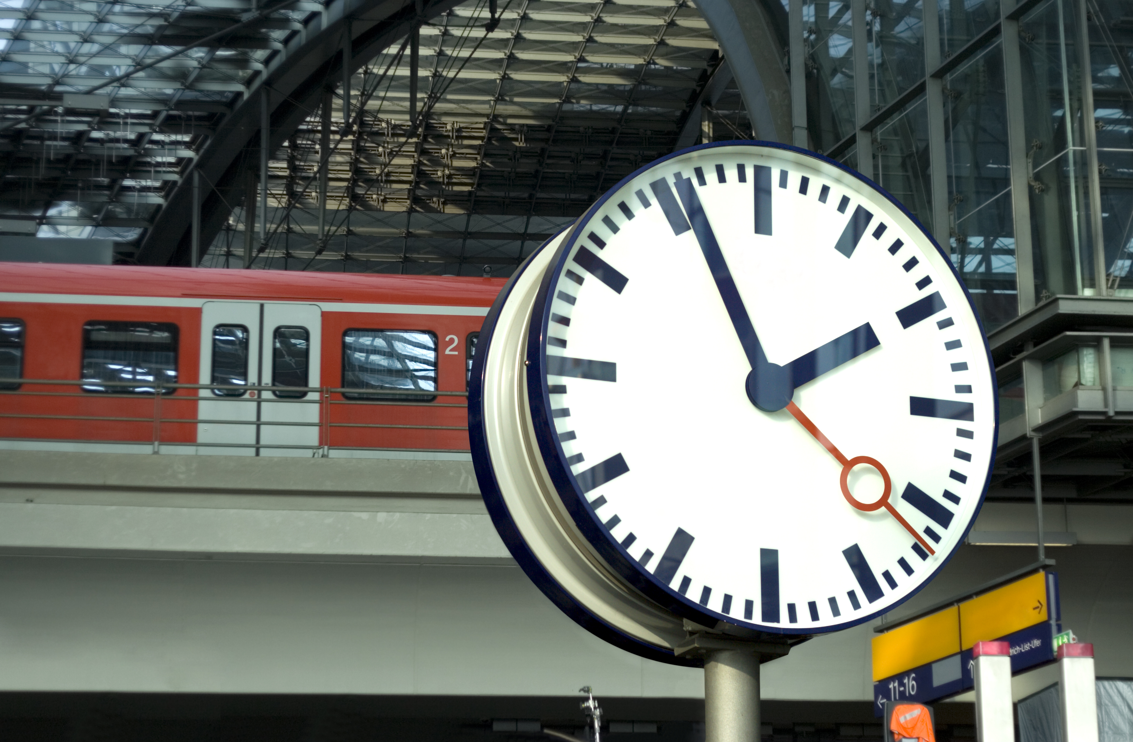
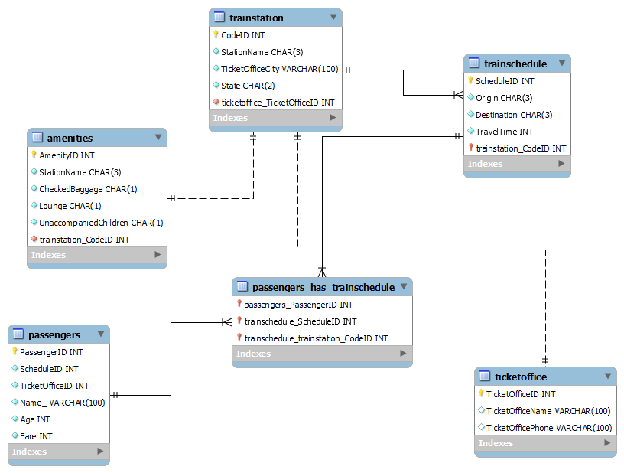
EER Diagram

Slide 6
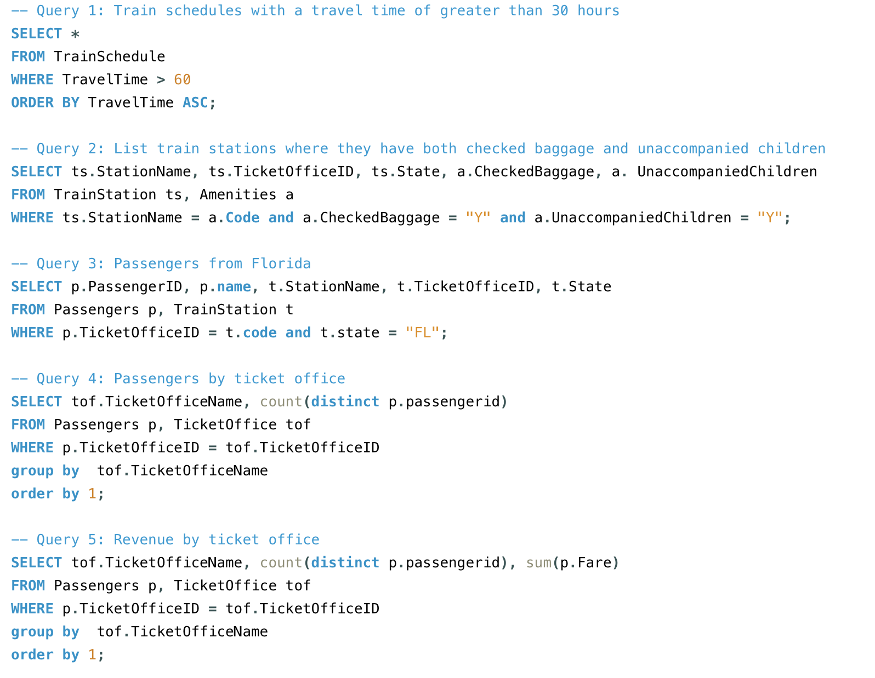


Most frequent sql statements

Slide 7
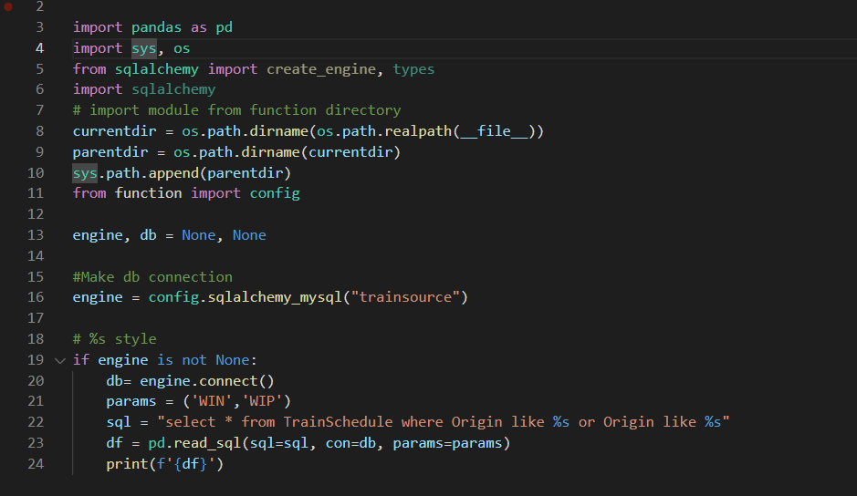
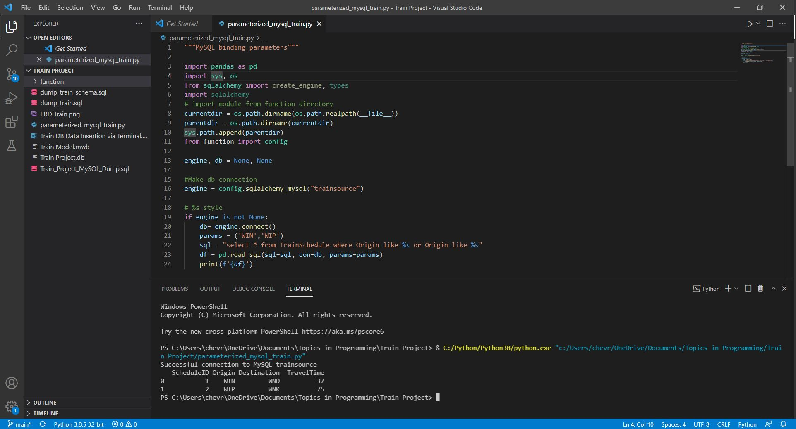
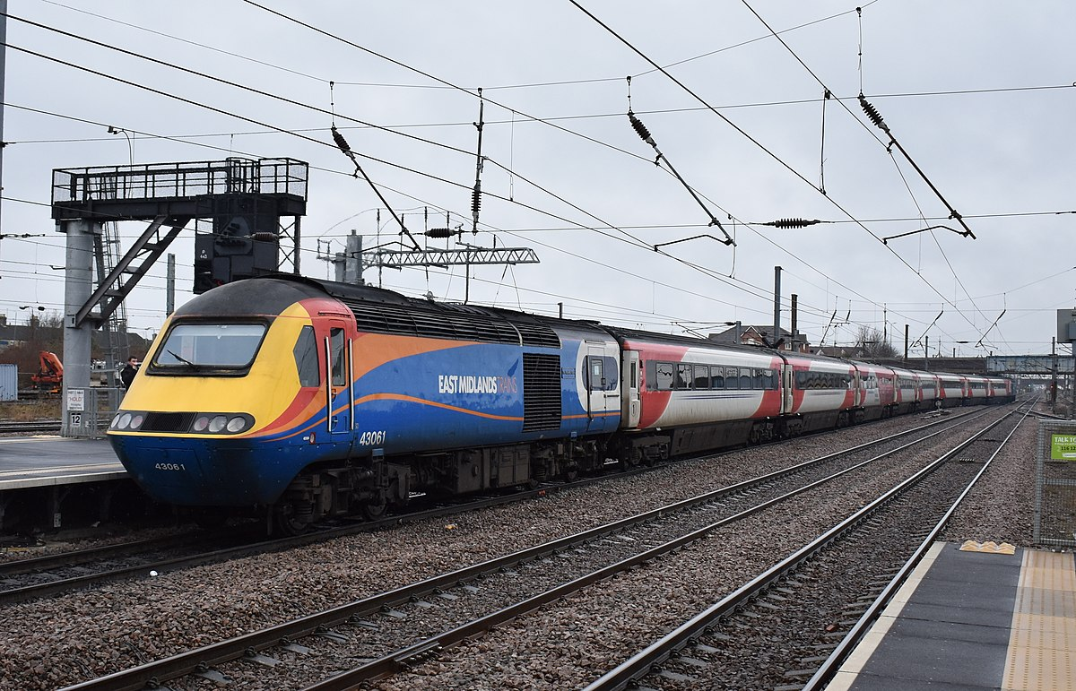
Parameterized mysql script
This Photo by Unknown author is licensed under CC BY-SA.

Slide 8

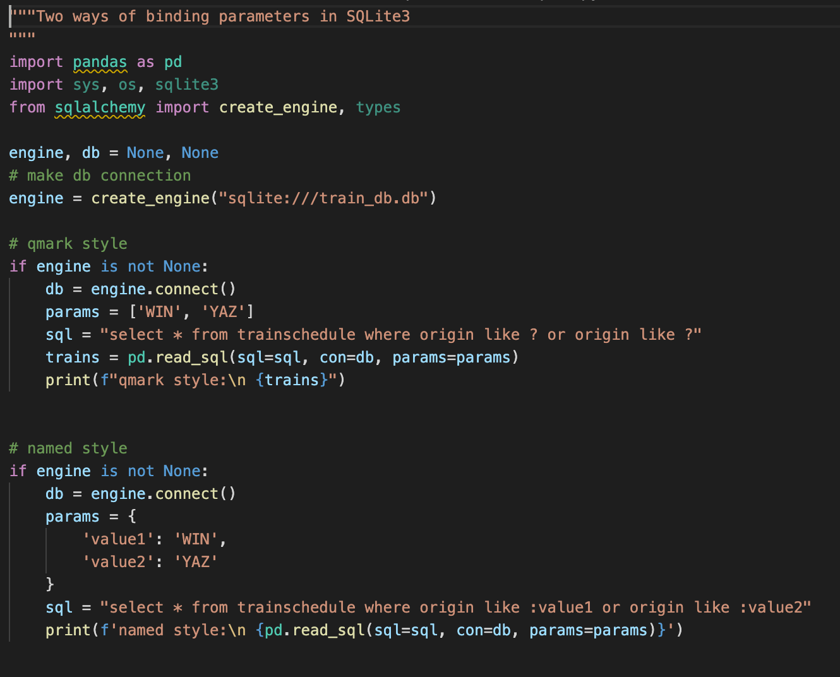
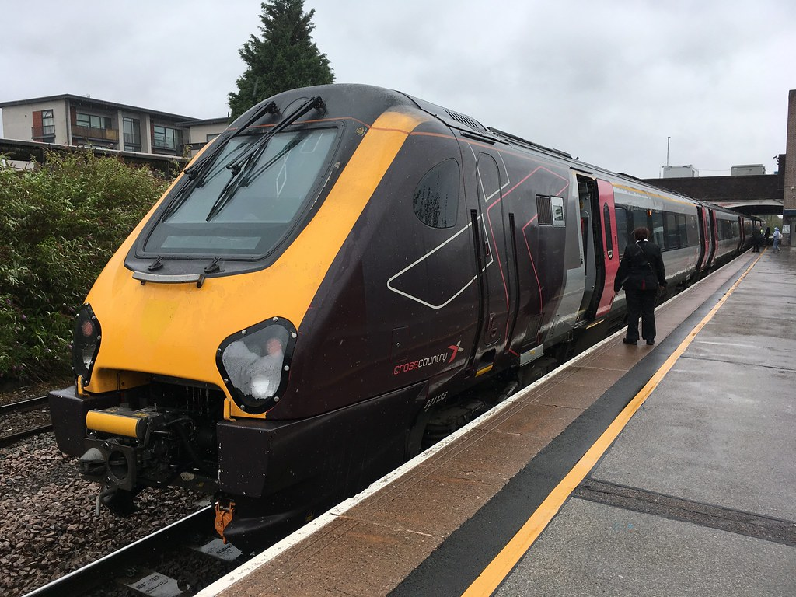
Parameterized Sqlite3 script
This Photo by Unknown author is licensed under CC BY-NC-ND.

Slide 9

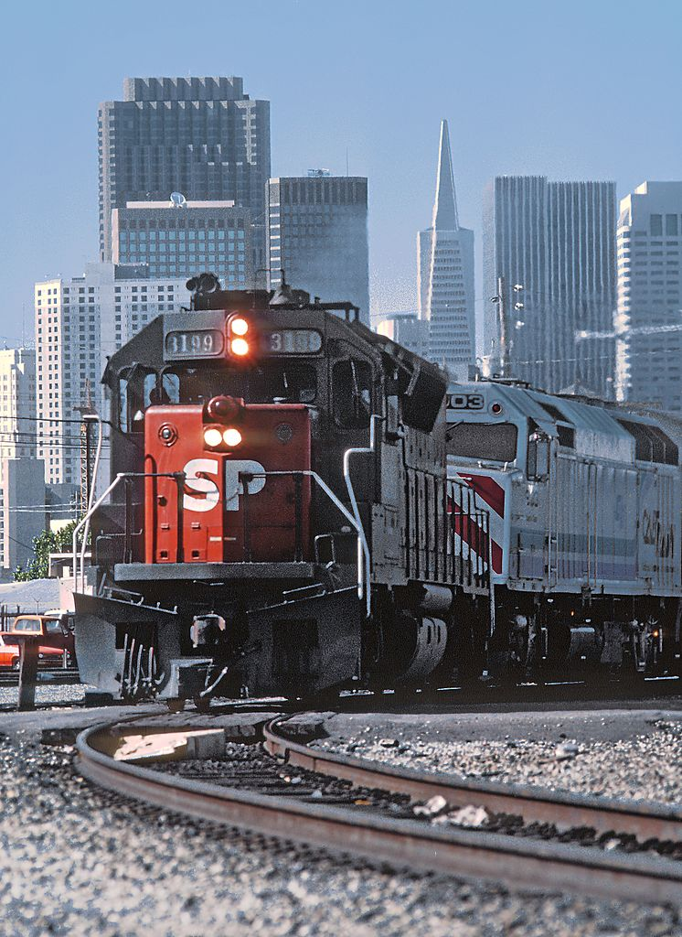
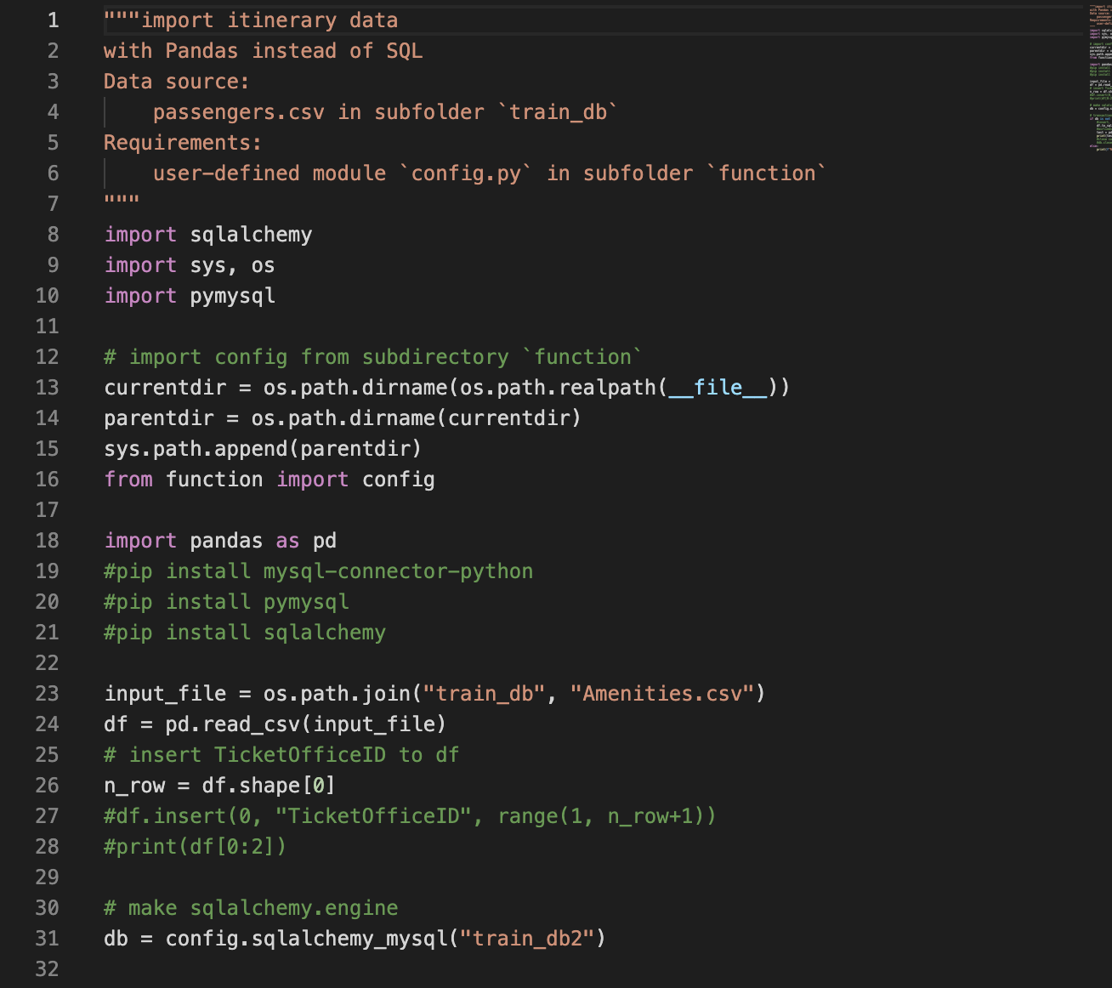
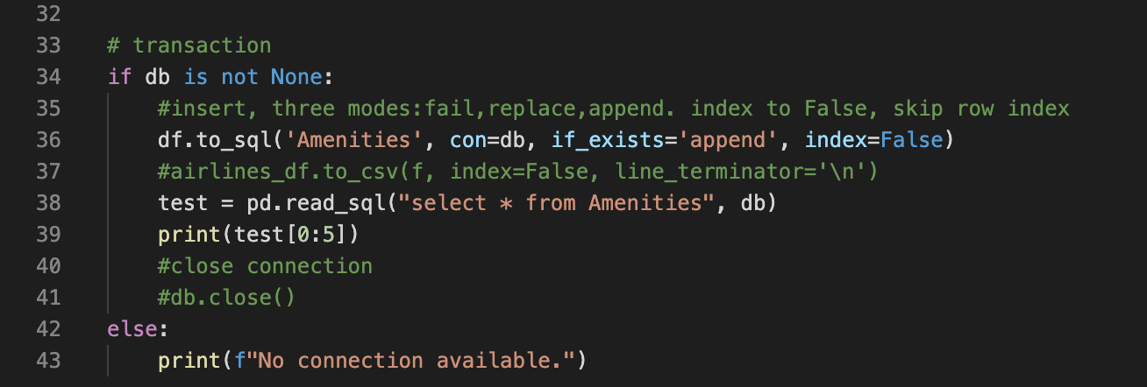
Script of csv Data
This Photo by Unknown author is licensed under CC BY-SA.

Slide 10
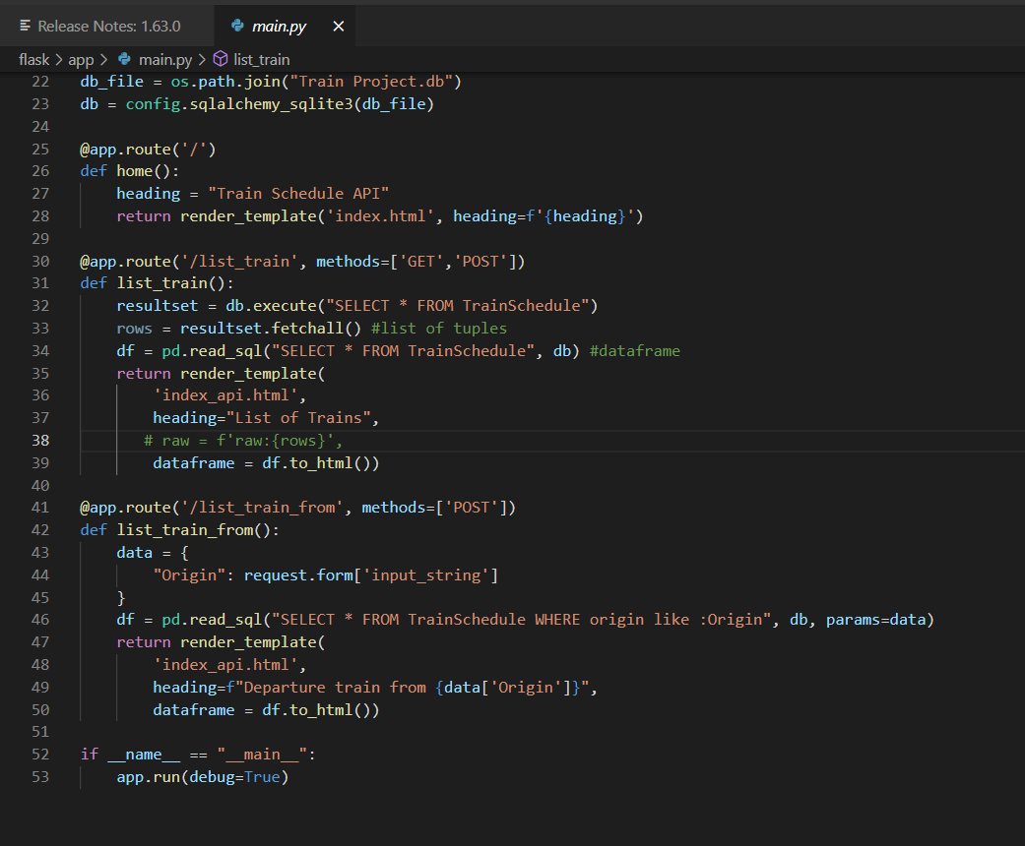
App code
Main python code used to create the app.

Slide 11
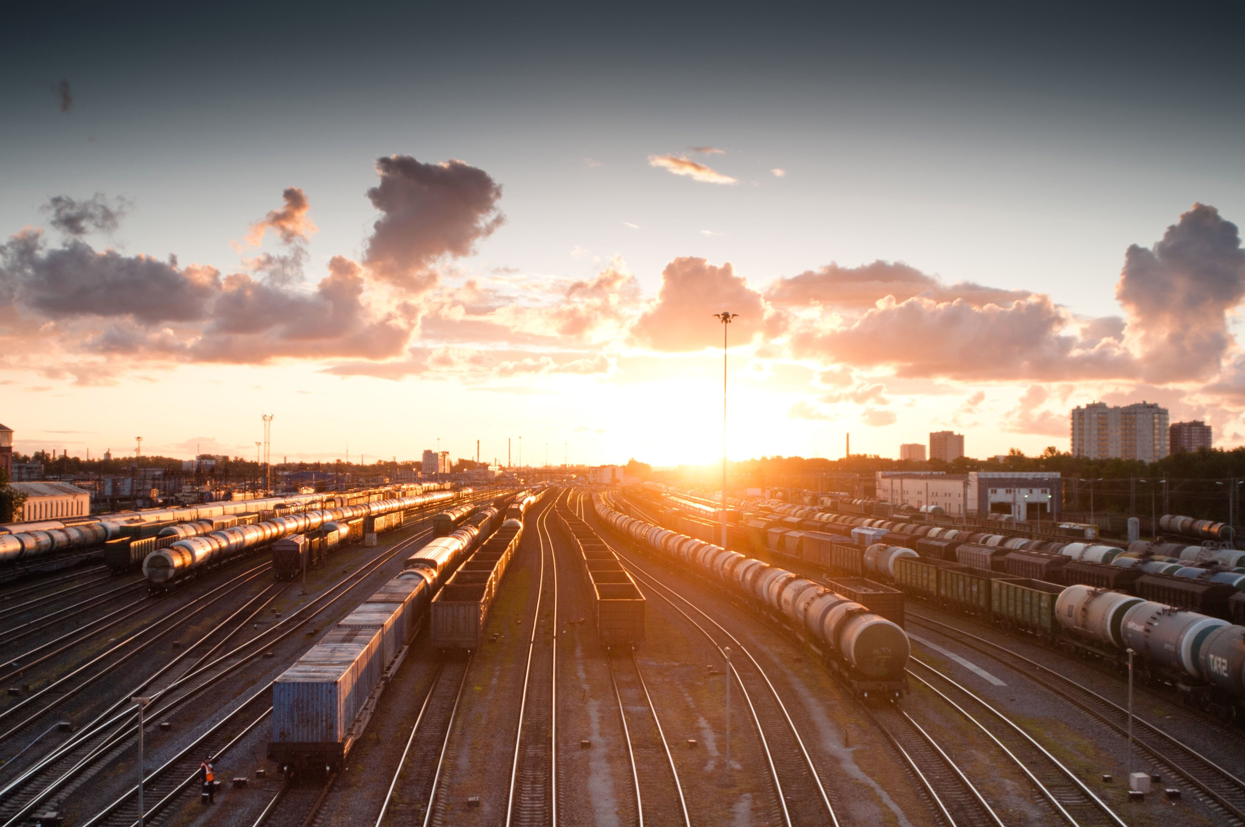
Python app link
http://127.0.0.1:5000/?

Slide 12

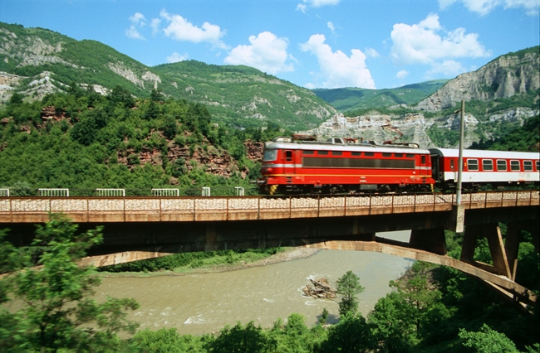
Heroku app link
This Photo by Unknown author is licensed under CC BY-SA.
https://young-temple-40326.herokuapp.com /

Slide 13
The end. Questions?

